Slide 1
Better Census Bureau
Sam Robinson, Sandra Medrano, Henry Wycislo,
and John Burke

Slide 2
Questions
What is the social vulnerability index?
What are any inherent biases for how the data is grouped?
How is the population split geographically in terms of education, social vulnerability and income?
How does Harris County compare to the U.S.?

Slide 3
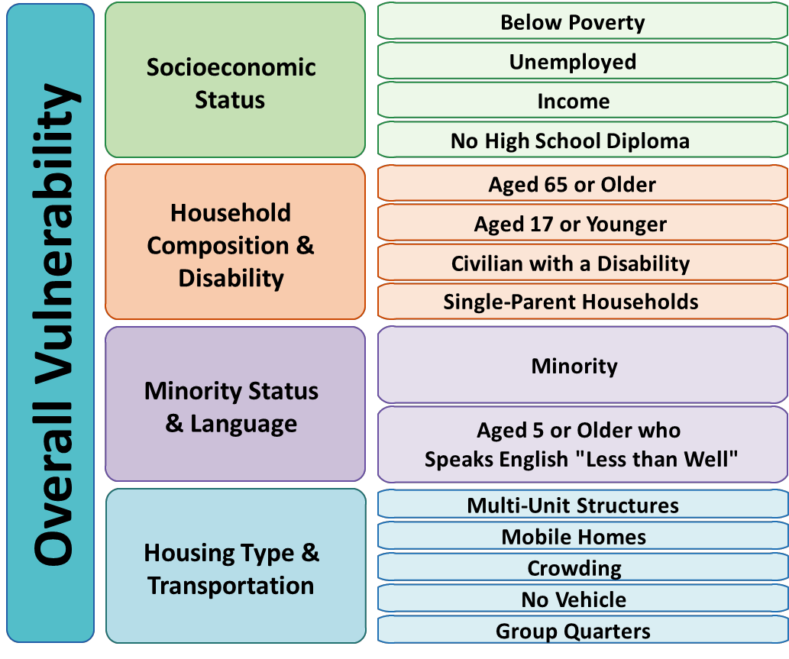
What IS Social vulnerability?
Social vulnerability refers to the potential negative effects on a community caused by external stresses. Those stresses can be natural or human-caused. Natural stresses can include tornados, hurricanes or diseases. Human-caused stresses can include lack of transportation, over-crowded housing or lack of economic opportunity.

Slide 4





Tools we used
HTML
CSS
JavaScript
GeoJSON
Python
Pandas
GeoPandas
PostgresSQL
Leaflet

Slide 5


Datasets USED

Slide 6
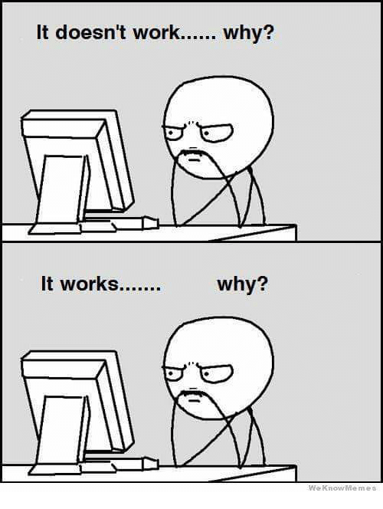
Difficulties we faced

Slide 7
Fin

Slide 8
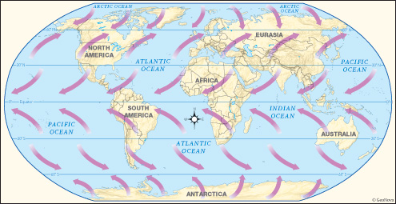
The effects of prevailing winds

